Slide 1
UNDERSTANDING
SATIRE
With a little help from fairy tales and a certain loveable ogre…

Slide 2
Fairy tales

Slide 3
Common Elements of Fairy Tales?
(I am not going to just tell you! Suggestions please….)

Slide 4
Common Elements of Fairy Tales?
1. A fairy tale begins with "Once upon a time...”
2. Fairy tales happen ‘long ago’.
3. Fairy Tales have fantasy and make-believe in them.
4. Fairy Tales have clearly defined Good characters vs. Evil characters.
5. Royalty is usually present in a fairy tale: a beautiful princess or handsome prince.
6. There may be magic with giants, elves, talking animals, witches or fairies.
7. Fairy tales have a problem that needs to be solved.
8. It often takes three tries to solve the problem.
9. Fairy tales have happy endings – “they all lived happily ever after.”
10. Fairy tales usually teach a lesson or have a theme.

Slide 5
Women in Fairy Tales
(How are women presented in fairy tales?)

Slide 6
Women in Fairy Tales
Cinderella?

Slide 7
Women in Fairy Tales
Cinderella?
Sleeping Beauty?

Slide 8
Women in Fairy Tales
Cinderella?
Sleeping Beauty?
Rapunzel?

Slide 9
Women in Fairy Tales
Damsels in distress
In need of a rescuer – usually a prince
Helpless
Dependent on the men around them, or on a magical element (fairy, witch etc)

Slide 10
Watch this movie clip and see how the female is presented in this fairy tale…

Slide 11
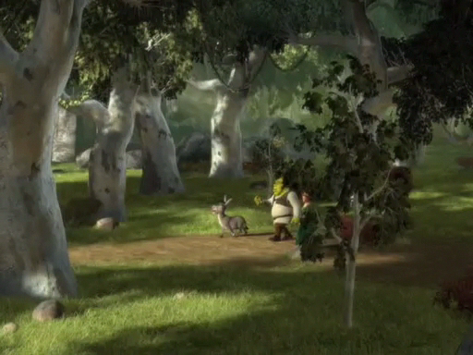
Watch video clip

Slide 12
Fiona
How is she unlike the traditional female in a fairy tale?

Slide 13
Fiona
How is she unlike the traditional female in a fairy tale?
(Again, I am not just going to give it to you… discuss!)

Slide 14
Fiona
How is she unlike the traditional female in a fairy tale?
Stands up for herself
The ‘rescuee’ becomes the ‘rescuer’
Not at all helpless
She does not need magic, she has martial arts

Slide 15
Why this reversal?

Slide 16
Why this reversal?
What does it say about women?

Slide 17
Why this reversal?
What does it say about women?
How does it say it?

Slide 18
Why this reversal?
What does it say about women?
How does it say it?
… through humour

Slide 19
Why this reversal?
What does it say about women?
How does it say it?
… through humour
This is called SATIRE

Slide 20
Satire:
A literary work that ridicules its subject through the use of techniques such as exaggeration, reversal, incongruity, and/or humour in order to make a comment or criticism about it.

Slide 21
Satire:
A literary work that ridicules its subject through the use of techniques such as exaggeration, reversal, incongruity, and/or humour in order to make a comment or criticism about it.
In Pairs, discuss how the video clip from Shrek is a satire of traditional fairy tales. Particularly how it relates to the presentation of ‘the damsel in distress’.
Do the makers of the film use any exaggeration, reversal, incongruity (something which is out of place) or humour?
What comment or criticism is being made?

Slide 22
Can you identify the satirical comment being made in this example?

Slide 23
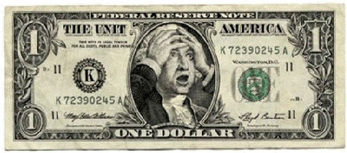
Can you identify the satirical comment being made in these examples?
Can you see any exaggeration, reversal, incongruity, and/or humour in this?

Slide 24
But identifying the humor is not enough.

Slide 25
But identifying the humor is not enough.
You then have to unpack it and work out what the author/artist is trying to say.

Slide 26
But identifying the humor is not enough.
You then have to unpack it and work out what the author/artist is trying to say.
What comment or criticism are they making?

Slide 27
Let’s see if we are any good at this…

Slide 28
Let’s see if we are any good at this…
Take some political satire, for example…
POLITICAL SATIRE: The particular use of satire (humour, parody, exaggeration etc) to make a political statement or comment. It can be in the form of a literary work, a cartoon, a play etc.

Slide 29
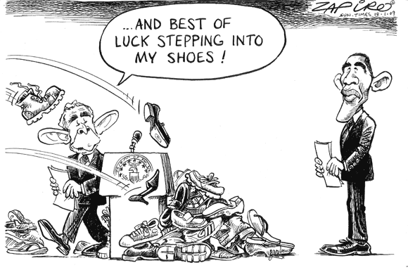

Slide 30
How is this funny?
What is the artist ‘saying’?

Slide 31
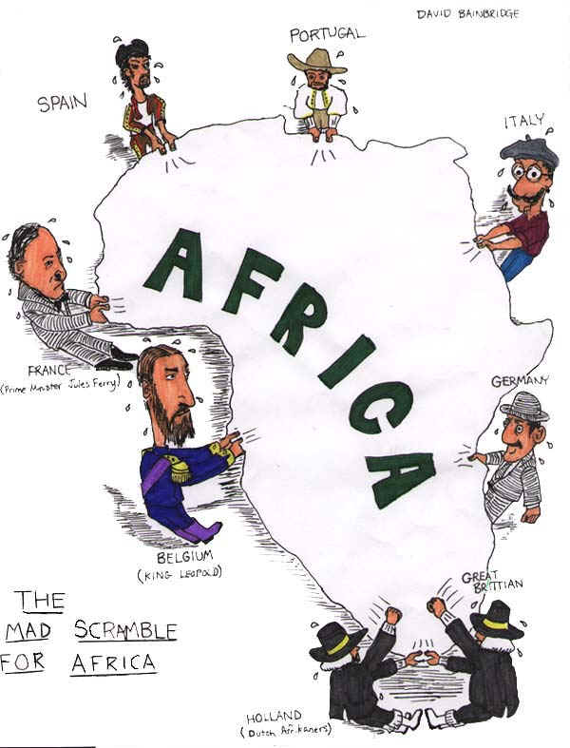
This is a cartoon about Europe’s colonization of Africa.
Does it use humor? Exaggeration? Reversal? Incongruity?
Why? What’s the serious message of this satirical cartoon?

Slide 32
Where else do we see satire?

Slide 33
Where else do we see satire?
Literature

Slide 34
Where else do we see satire?
Literature
Mark Twain often used satire in his writing.

Slide 35
Where else do we see satire?
Literature
Mark Twain often used satire in his writing.
Jonathan Swift (who wrote Gulliver’s Travels) used satire in his literature. He even said, “Satire is a sort of glass, wherein beholders do generally discover everybody's face but their own.”

Slide 36
Where else do we see satire?
Literature
Mark Twain often used satire in his writing.
Jonathan Swift (who wrote Gulliver’s Travels) used satire in his literature. He even said, “Satire is a sort of glass, wherein beholders do generally discover everybody's face but their own.”
George Orwell used satire most famously in his novels Animal Farm, and 1984.

Slide 37
Where else do we see satire?
Literature
Mark Twain often used satire in his writing.
Jonathan Swift (who wrote Gulliver’s Travels) used satire in his literature. He even said, “Satire is a sort of glass, wherein beholders do generally discover everybody's face but their own.”
George Orwell used satire most famously in his novels Animal Farm, and 1984.
Television

Slide 38
Where else do we see satire?
Literature
Mark Twain often used satire in his writing.
Jonathan Swift (who wrote Gulliver’s Travels) used satire in his literature. He even said, “Satire is a sort of glass, wherein beholders do generally discover everybody's face but their own.”
George Orwell used satire most famously in his novels Animal Farm, and 1984.
Television
Sketch shows such as Saturday Night Live.

Slide 39
Where else do we see satire?
Literature
Mark Twain often used satire in his writing.
Jonathan Swift (who wrote Gulliver’s Travels) used satire in his literature. He even said, “Satire is a sort of glass, wherein beholders do generally discover everybody's face but their own.”
George Orwell used satire most famously in his novels Animal Farm, and 1984.
Television
Sketch shows such as Saturday Night Live.
TV series such as Last Man Standing, The Simpsons and Family guy often poke fun at politics and politicians in a satirical way.

Slide 40
Where else do we see satire?
Literature
Mark Twain often used satire in his writing.
Jonathan Swift (who wrote Gulliver’s Travels) used satire in his literature. He even said, “Satire is a sort of glass, wherein beholders do generally discover everybody's face but their own.”
George Orwell used satire most famously in his novels Animal Farm, and 1984.
Television
Sketch shows such as Saturday Night Live.
TV series such as Last Man Standing, The Simpsons and Family guy often poke fun at politics and politicians in a satirical way.
Comedians certainly rely on satire in their work.

Slide 41
Where else do we see satire?
Literature
Mark Twain often used satire in his writing.
Jonathan Swift (who wrote Gulliver’s Travels) used satire in his literature. He even said, “Satire is a sort of glass, wherein beholders do generally discover everybody's face but their own.”
George Orwell used satire most famously in his novels Animal Farm, and 1984.
Television
Sketch shows such as Saturday Night Live.
TV series such as Last Man Standing, The Simpsons and Family guy often poke fun at politics and politicians in a satirical way.
Comedians certainly rely on satire in their work.
Print media

Slide 42
Where else do we see satire?
Literature
Mark Twain often used satire in his writing.
Jonathan Swift (who wrote Gulliver’s Travels) used satire in his literature. He even said, “Satire is a sort of glass, wherein beholders do generally discover everybody's face but their own.”
George Orwell used satire most famously in his novels Animal Farm, and 1984.
Television
Sketch shows such as Saturday Night Live.
TV series such as Last Man Standing, The Simpsons and Family guy often poke fun at politics and politicians in a satirical way.
Comedians certainly rely on satire in their work.
Print media
Ever looked at the editorial cartoons in newspapers? They are one of the oldest ways of using satire to make a political statement.

Slide 43
Where else do we see satire?
Literature
Mark Twain often used satire in his writing.
Jonathan Swift (who wrote Gulliver’s Travels) used satire in his literature. He even said, “Satire is a sort of glass, wherein beholders do generally discover everybody's face but their own.”
George Orwell used satire most famously in his novels Animal Farm, and 1984.
Television
Sketch shows such as Saturday Night Live.
TV series such as Last Man Standing, The Simpsons and Family guy often poke fun at politics and politicians in a satirical way.
Comedians certainly rely on satire in their work.
Print media
Ever looked at the editorial cartoons in newspapers? They are one of the oldest ways of using satire to make a political statement.
The Internet

Slide 44
Where else do we see satire?
Literature
Mark Twain often used satire in his writing.
Jonathan Swift (who wrote Gulliver’s Travels) used satire in his literature. He even said, “Satire is a sort of glass, wherein beholders do generally discover everybody's face but their own.”
George Orwell used satire most famously in his novels Animal Farm, and 1984.
Television
Sketch shows such as Saturday Night Live.
TV series such as Last Man Standing, The Simpsons and Family guy often poke fun at politics and politicians in a satirical way.
Comedians certainly rely on satire in their work.
Print media
Ever looked at the editorial cartoons in newspapers? They are one of the oldest ways of using satire to make a political statement.
The Internet
The internet is FULL of cartoons, editorials, YouTube videos and articles which use satire. You just have to look out for it…

Slide 45
Got it?

